Slide 1
Chapter 12
Potential Energy

Slide 2
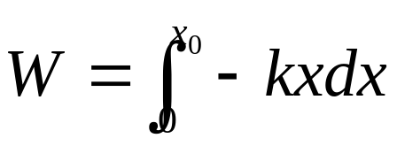
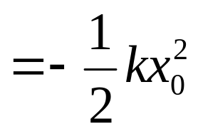
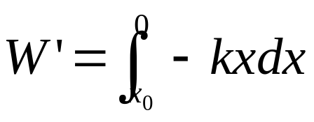
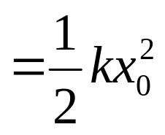



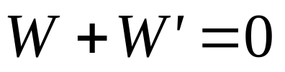
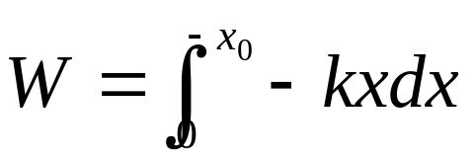
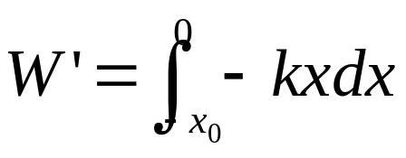
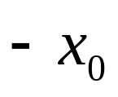
Conservative forces
no total work during any round trip

Slide 3
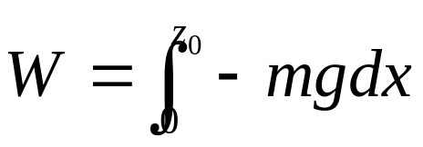
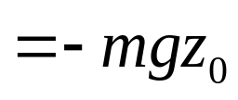


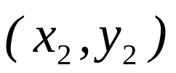
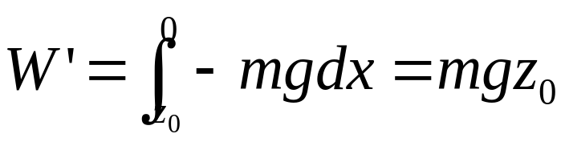
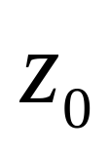
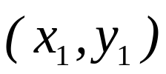
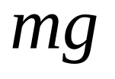

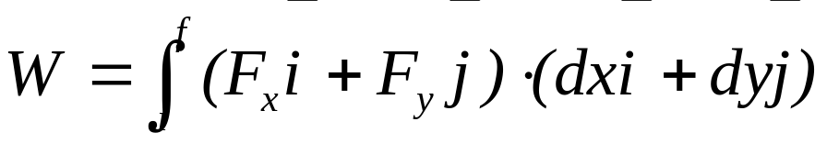
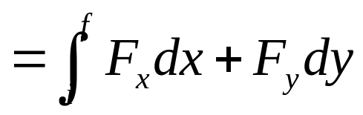
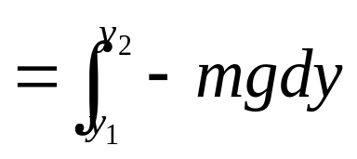
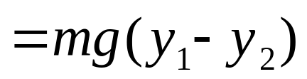
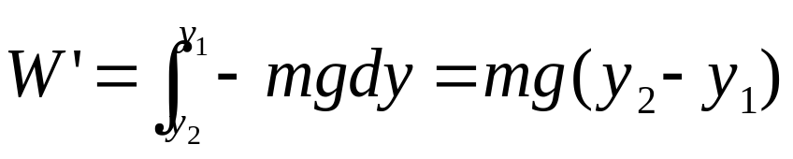
no total work during any round trip
no total work during any round trip

Slide 4
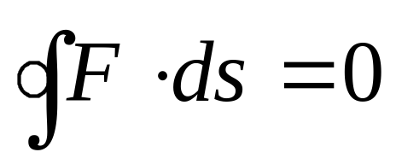
If a body moves under a force that does no total work during any round trip.
conservative force
The spring force, gravity and universal gravitation are three examples of conservative force.
no total work during any round trip

Slide 5
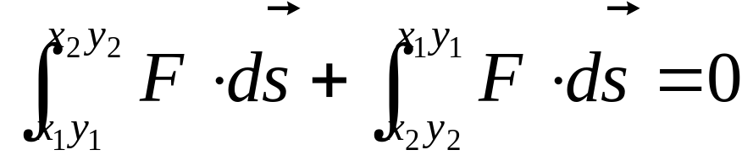
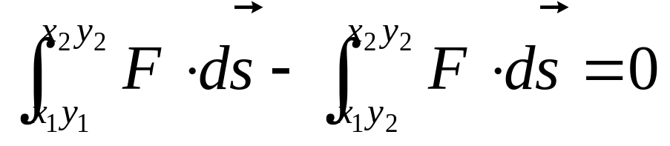
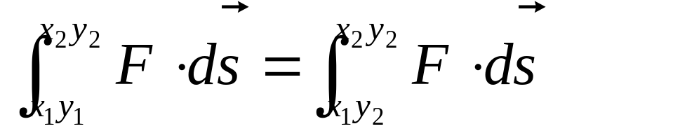
If a body moves under a force that does no total work during any round trip.
conservative force
If the work done by a force is independent of the path. This force is a conservative force
The spring force, gravity and universal gravitation are three examples of conservative force.

Slide 6
Potential
Energy
Energy
Work
done by conservative force
independent of the path
dependent on the position

Slide 7
Because the work done by the conservative force is independent of the path taken between the two point, we can introduce a new concept,
potential energy
represented by the symbol U.
We define the change in potential energy associated with a single force as:
- ΔU=U_{i} -U_{f}= W
ΔU=U_{i} -U_{f}= - W

Slide 8
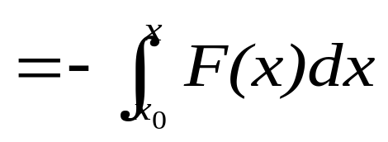
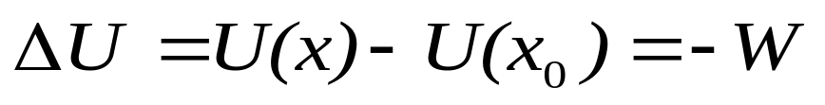
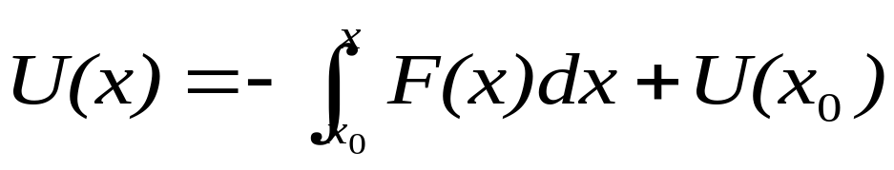
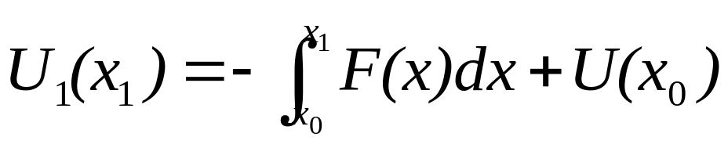
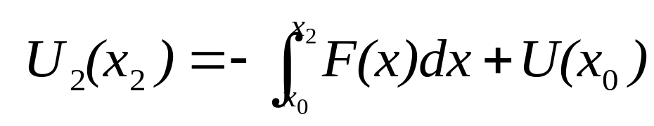
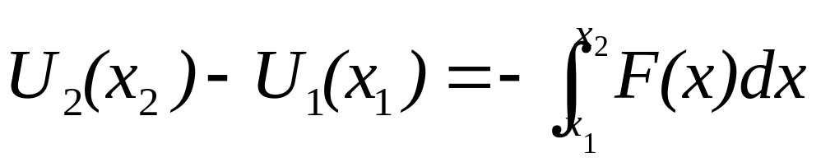
For a particle in one dimensional motion acted on by a conservative force F(x), it moves from the initial coordinate x₀ to the final coordinate x.
Here U(x₀) is potential energy of an arbitrary reference point. It can be free to choose any convenient value because it can not change the difference of potential energy for two locations.

Slide 9
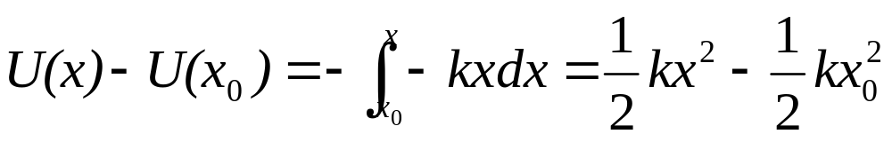
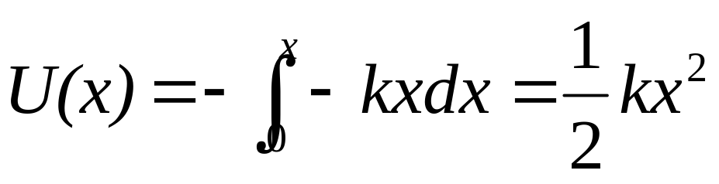
The spring force : F(x)= -kx
If we choose the reference position x₀ of the block in the spring being its relaxed state (x₀ =0), and declare U(x₀)=0.

Slide 10
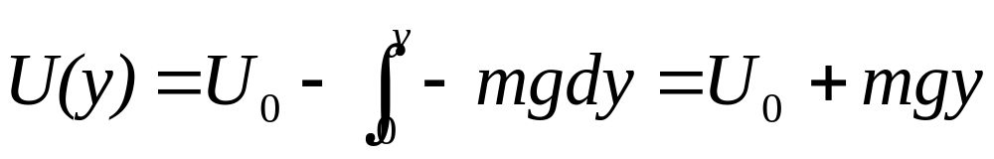
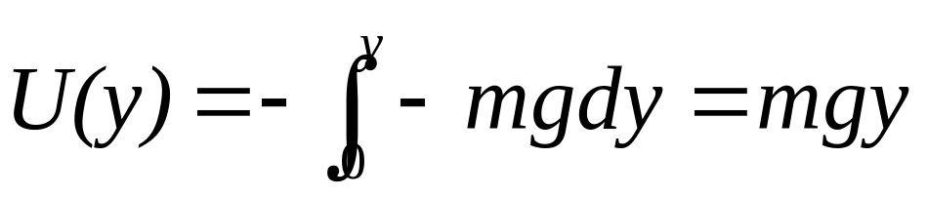
The force of gravity: F(y)=-mg
If we choose the reference point y₀ at the surface of the earth and y₀ =0, we define U(y₀)=0.

Slide 11

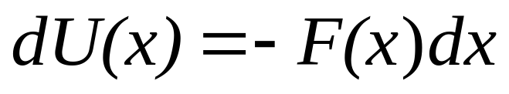
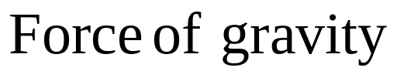
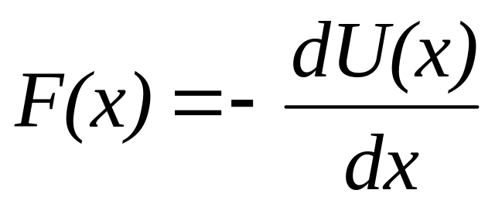
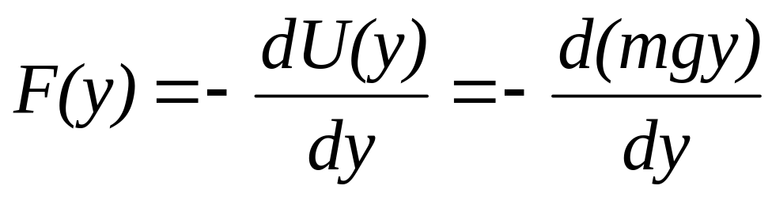
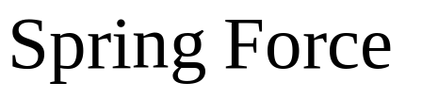
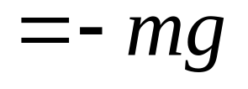
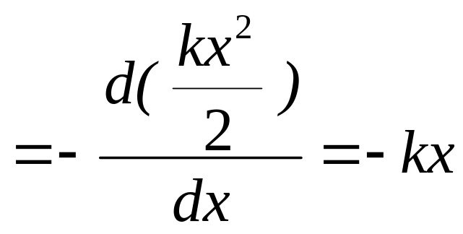
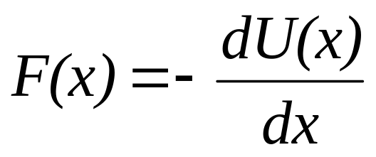
The relation between force and potential energy:

Slide 12
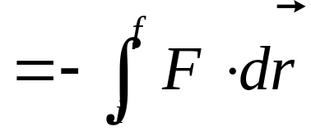
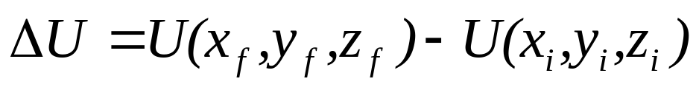
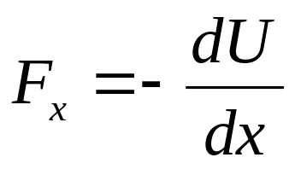
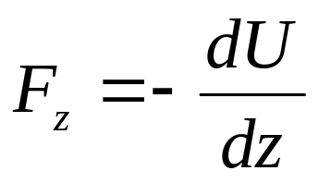
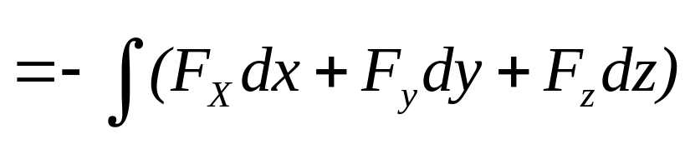
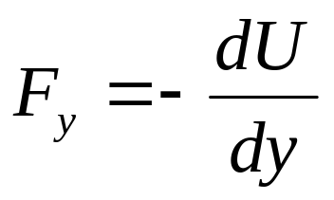
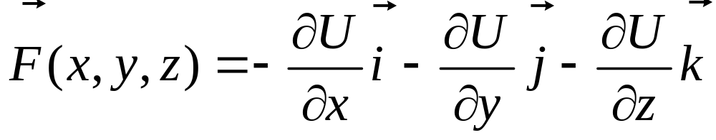

Three-dimensional conservative systems
A particle moves along a path from i to f. A conservative force F acts on the particle.
F is the negative gradient of the potential energy U(x,y,z).

Slide 13
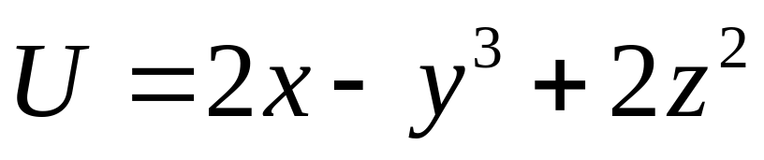


Example:

Slide 14
Conservation of mechanical energy
Consider an isolated system: The internal forces are conservational forces
W= -ΔU
W=Δ K
ΔK= - ΔU
Δ(K+U)=0
K+U=E=constant
E is called mechanical energy of the conservative system.

Slide 15






In moving from x₀ to x, the velocity of a particle it is acted on a conservative force will change from v₀ to v.

Slide 16









One-dimensional conservation systems:
Force =0
equilibrium points
Unstable equilibrium
Neutral equilibrium
Stable equilibrium

Slide 17














Example:
Find v of the rolling cylinder when the center of mass move down from height h at the rest.
N
f
mg
θ

Slide 18



Example:
Find v of the rolling cylinder when the center of mass move down from height h at the rest.
N
f
mg
θ

Slide 19









A solid ball with mass m and radius r
Example

Slide 20





A solid ball with mass m and radius r
Example

Slide 21




A solid ball with mass m and radius r
Example

Slide 22
m, L

Slide 23









m, L

Slide 24















Example: The potential energy function for the force between two atoms in a diatomic molecule can be expressed approximately as follows:
Find (1) the force between the atoms. (2) the equilibrium separation between the atoms. (3) the minimum energy necessary to break the molecule apart.
x

Slide 25
CHAP.11
Problem 31, 32 (P255)
CHAP.12
Exercises 7, 9 (P272)
15 (P273)

